Slide 1
Thermal and barometric constraints on the intrusive and unroofing history of the Black Mountains: Implications for timing, initial dip, and kinematics of detachment faulting in the Death Valley region, California
Holm & Snow 1992

Slide 2
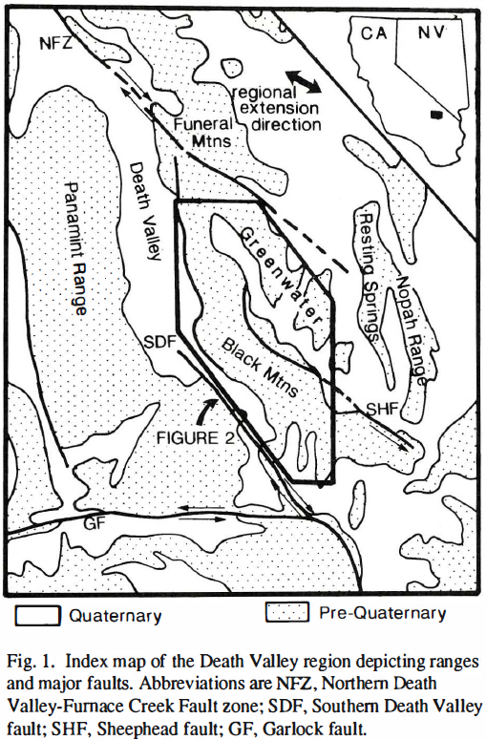
Background
Black Mountains are centrally located in Death Valley with the Sierras to the West & Spring Mtns. to the East
Primarily Miocene intrusions of gabbroic to dioritic compostion (intruded into Proterozoic basement)
Late Miocene silicic complex of granitic to monzonitic rocks
Metamorphic core complex ~1.7Ga exposed on the Western edge of the range composed of gneissic-schistose metaseds referred to as “turtlebacks”

Slide 3
Purpose
To determine timing, pattern, and amount of unroofing in the Black Mtns. in order to understand lithospheric deformation
To use ⁴⁰Ar/³⁹Ar cooling ages to constrain Miocene intrusive history and unroofing in the Black Mountains
To understand pre-extensional depths, initial dips, and over kinematics of the range

Slide 4
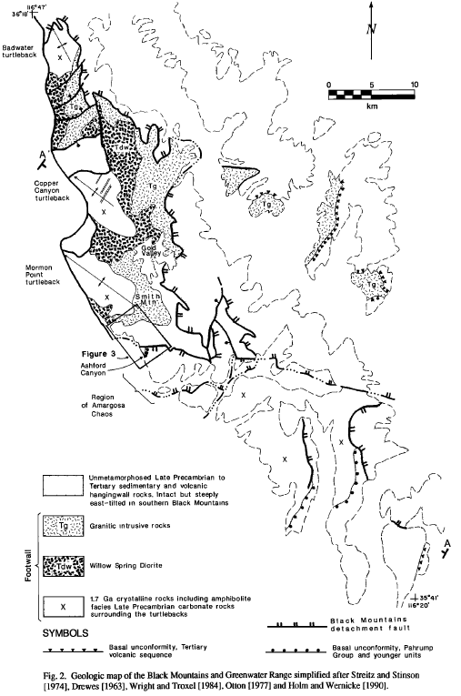
Methods
⁴⁰Ar/³⁹Ar cooling age data and barometry on 18 syn-extensional intrusions across 55km
30 age dates from 18 localities were taken across 5 differing mineral systems

Slide 5
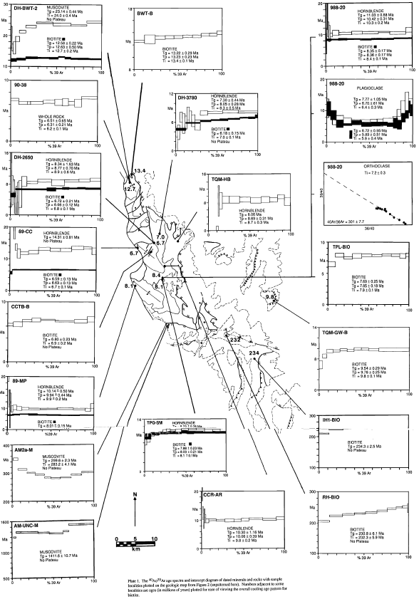
Results (ages)
Pre-Cambrian Basement (meta core complex)
1411.6±10.7 Ma (muscovite separate)
Willow Spring Diorite (~11.6 Ma)
11.6±0.2 Ma (Asmerom et al. 1990)
10.42±0.31 Ma (hornblende separate)
8.4-6.7Ma (biotite ages) here thought to represent cooling associated with extensional unroofing
Smith Mountain Granitic Complex (~8.7 Ma)
8.7±0.1 Ma (hornblende separate)
8.1±0.1 Ma (biotite separate)
Mylonitic Deformation (~8.9 Ma)
8.9±0.6 Ma (hornblende separate)
6.8±0.1 Ma (biotite separate)

Slide 6
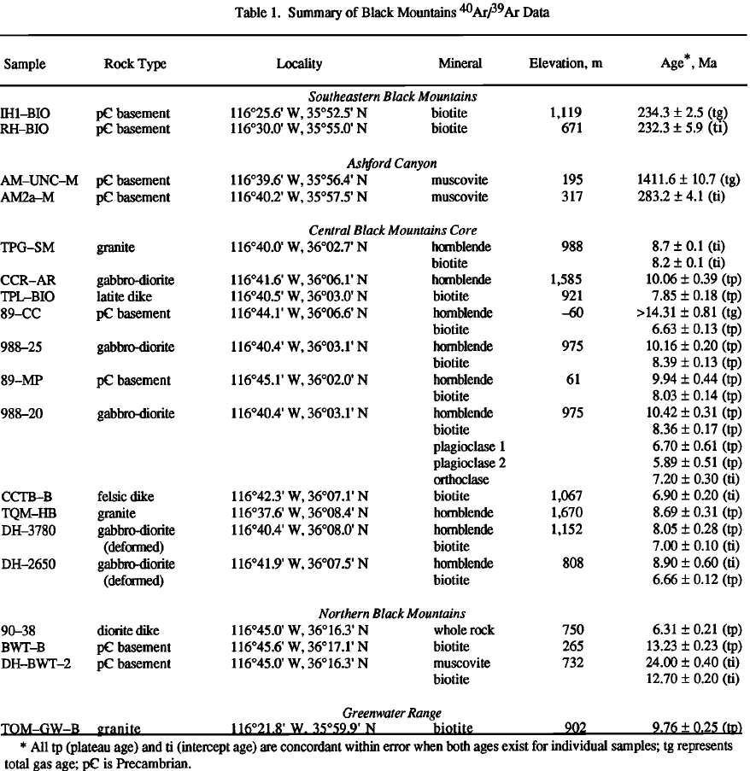
Barometry (paleodepth)
Willow Spring Diorite
Upper Bound 16.7-20km (hornblende cooling temp of 500°C)
Lower Bound 10-12km (biotite cooling temp 300°C)
Smith Mountain Granite Complex
8.2-11.8km (biotite cooling temp 300°C)

Slide 7
Discussion
Willow Spring Pluton (Diorite)
~11.6Ma intruded at depth 10-15km
Smith Mountain Granite
~8.7Ma intruded at depth of 8.2-11.8km
Cooling patterns in biotite ages of the Willow Spring plutons show decreasing ages toward the Northwest
Dike intrusion ages also decrease toward the Northwest

Slide 8
Interpretations
Using time & depth constraints
Unroofing between 9-10Ma
Unroofing rates found to be 0-2.2mm/yr between 11.6-8.7Ma with more rapid rates >2.3-3.2mm/yr after 8.7Ma
Granitic plutons ~10Ma were unroofed shortly after crystallization by ~9Ma
Exhumation of 10-15km of crystalline rocks of the Black Mtns. along a NW direction
Cooling Age Pattern
Unroofing of plutons toward the northwest, consistent with regional extension direction
Similar with dikes

Slide 9
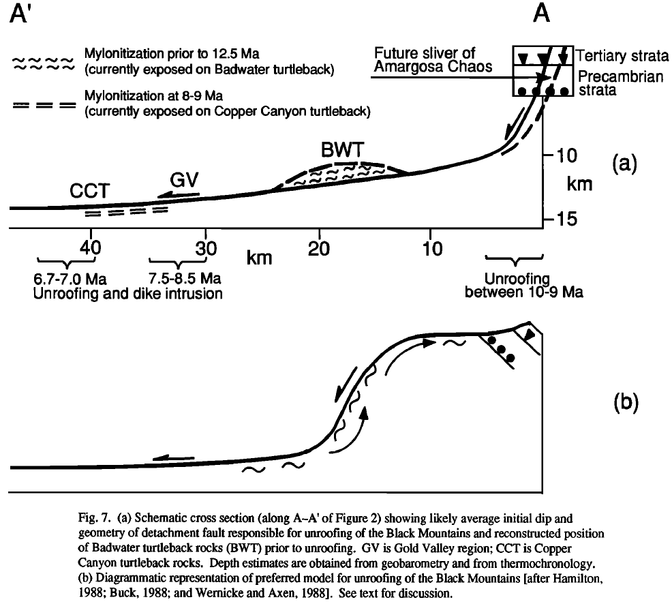
Unroofing Models
“As extension and unloading of the footwall occurs, isostatic forces cause the footwall to flex and uplift, resulting in migration of the flexure through the footwall”
Seen by the NW cooling pattern and unroofing progressively through the range
Initial average dip of the system ~20° with max of ~30°
Deepest portions of the black mountains were at a maximum depth of 15km prior to onset of unroofing
The SE Black Mountains were at shallow crustal levels (<300°C) well before Tertiary extension

Slide 10
Assumptions
Closure Temps
Hornblende 500 ±25°
Muscovite 350 ±25°
Biotite 300 ±25°
Willow Spring Pluton paleodepth
Basin & range geothermal gradients of 25-30°C/km
Determining Initial Dip
Only 3-5km of overburden above nonconformity and extension of 10-20% within the range block

Slide 11
Conclusion
Take Home Points
⁴⁰Ar/³⁹Ar dating of intrusions within the Black Mtns. resulted in age and depth constraints of intrusive complexes
Southeastern Black Mountains were at shallow crustal levels before onset of Tertiary extension
Unroofing of complexes between 9-10Ma with rates between 0-3.2mm/yr
Exhumation of 10-15km of crystalline rocks of the Black Mtns. along a NW direction subparallel to regional extension

